Slide 1
Post-election Reactions
Gebremedhin Melaku | MIS 670 Final Project | December 2020

Slide 2
Introduction
The first Presidential election occurred in 1788
A total of 58 elections so far
Running a successful campaign is key in winning the presidency
Winner of national popular votes also carried the electoral board in 53 out of 58 elections
If results are tied, the House of Representatives determines the winner.

Slide 3
Objective
In this project, we would like to assess Twitter Users’ reaction to the 2020 elections. The project is intended to answer the following questions
How do Americans react to 2020 elections? (The overall sentiment of supporters of both candidates)
How should Candidates run their campaign in the future? (especially in relation to social media users)

Slide 4
Methodology
Tweepy used to collect JSON files using the official accounts of Joe Biden and Donald Trump
A total of close to 480,000 tweets were collected.
JSON file stored into python list
Basic twitter statistics were computed prior to data cleaning
Lists were converted to CSV files to ease conversion into pandas dataframe
CSV files read into pandas dataframe

Slide 5
Methodology continued….
Alphanumeric objects were removed from the dataframe
Brackets, parentheses, common English words and short words cleaned out
Tweets tokenized and lemmatized using NLTK package
Word clouds of cleaned tweets were drawn using matplotlib
Sentiment analysis (Polarity and subjectivity) were done using pattern, TextBlob and Vader
Descriptive statistics of Word counts, character counts, average word length and Hashtag counts were done
Histogram of character counts plotted using matplotlib

Slide 6
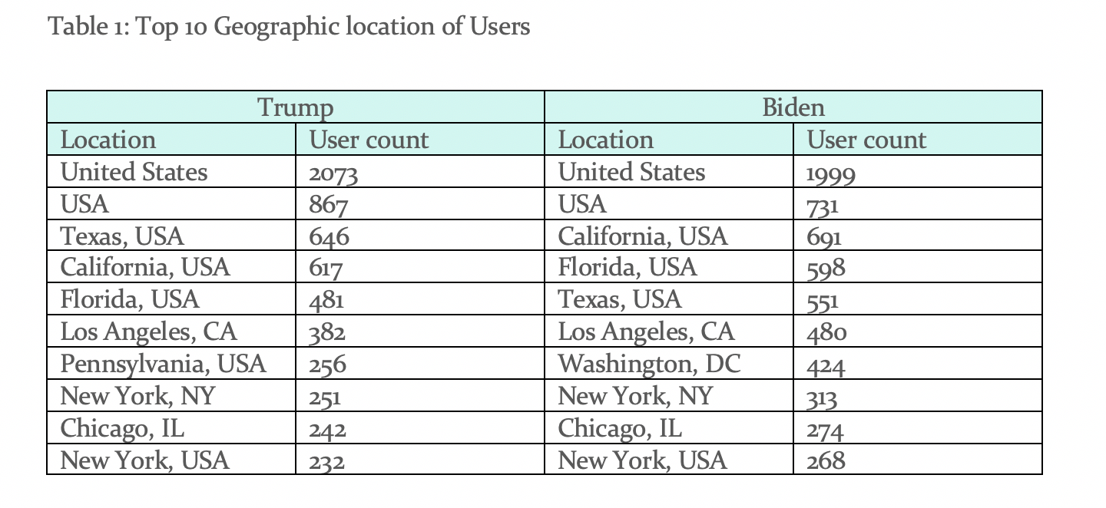
Results and Discussions
Tweets per user for Trump 1.97
Tweets per user for Biden 1.57

Slide 7
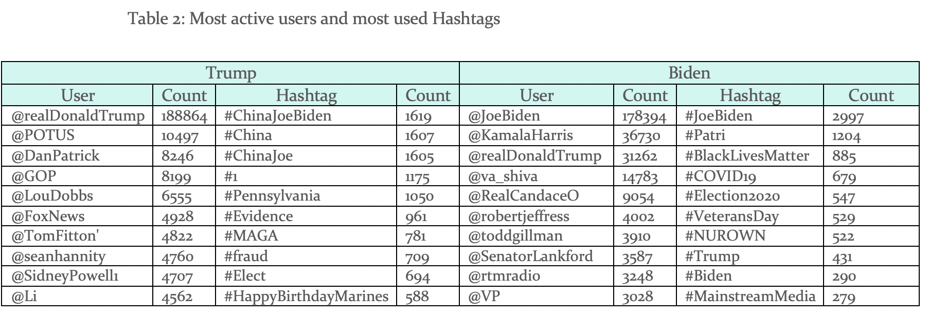
Results and discussions continued
#ChinaJoeBiden the commonest hashtag for Trump’s tweet
#JoeBiden was the commonest hashtag for Biden’s tweet

Slide 8
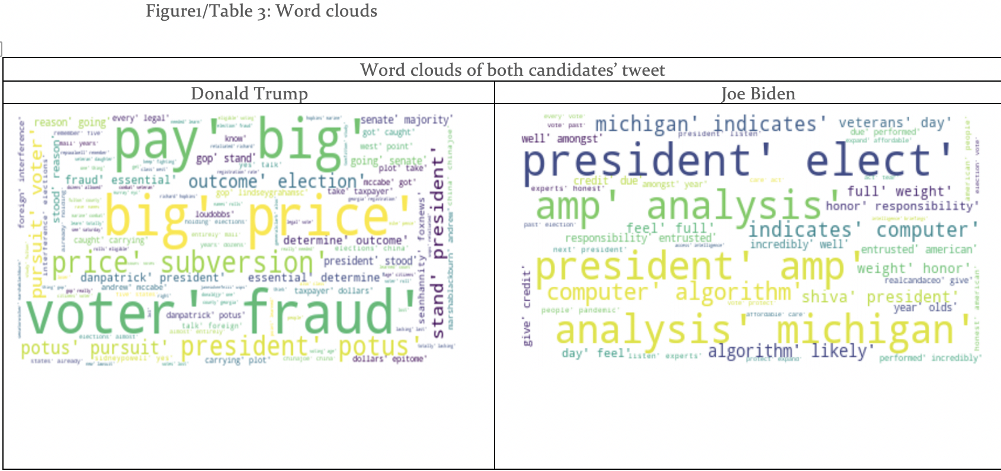
Results and discussions continued
“Voter fraud” the commonest phrase in Trump’s tweet
“President elect” the commonest phrase in Bidens Tweet

Slide 9
Results and discussions continued
Trump tweets had a polarity of 0.06 and subjectivity of 0.48
Biden’s tweet had a polarity of 0.16 and subjectivity of 0.52
Pattern and TextBlob returned similar values of polarity and subjectivity for both candidates
Trump tweets had a polarity of -0.03 using Vader compared with 0.12 to that of Biden’s

Slide 10
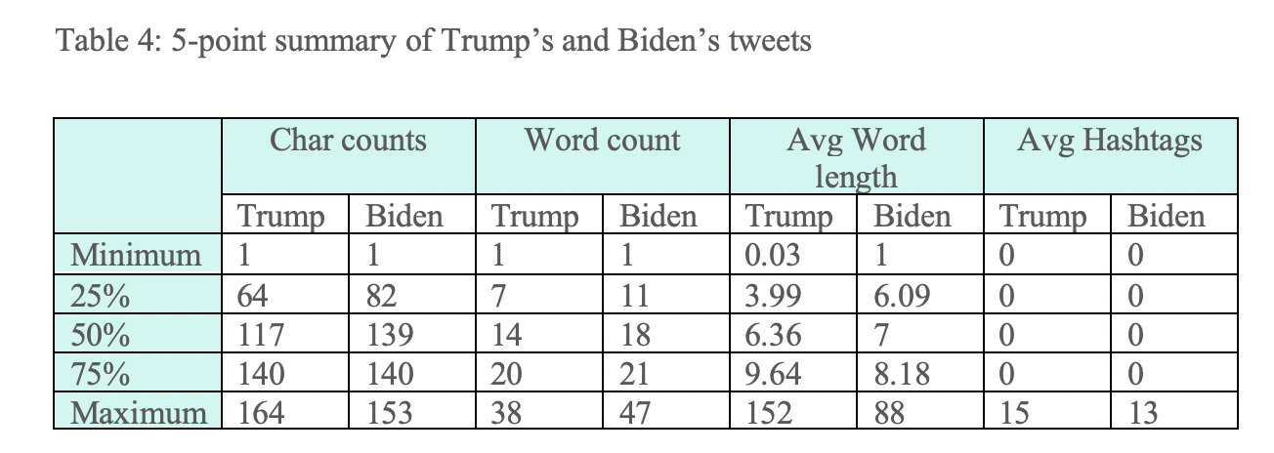
Results and discussions continued
The average character counts of Trump’s tweet were 101 compared with 111 to that of Biden’s. The average word counts of Trump’s tweets were 13.8 compared with 15.9 to that of Biden’s.

Slide 11
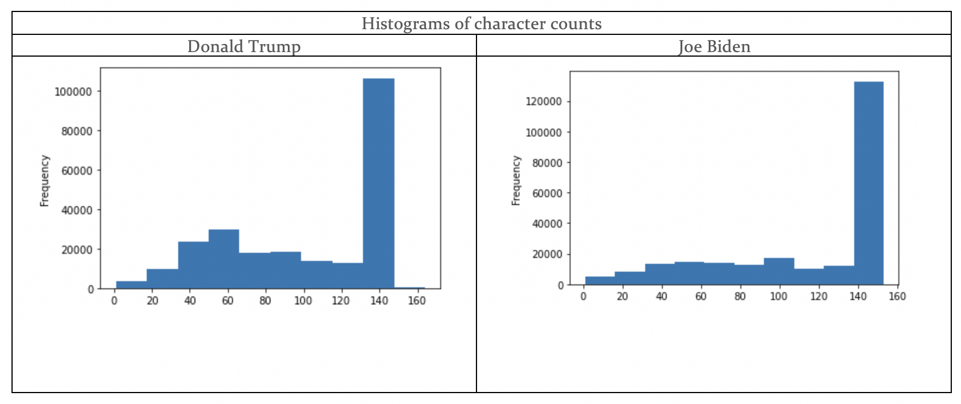
Results and discussions continued
69.4% of Biden’s tweet had character length of more than 100 compared with 55.6% to that of Donald Trump’s.

Slide 12
Conclusions
Both Trump’s and Biden’s tweets are fairly neutral
Tweets from both Candidates were halfway between objective and subjective.
Tweets in relation to the official account of Joe Biden tends to be longer than tweets in relation with the official account of Donald Trump
Candidates in the future should focus on reaching out active social media users especially in swing states such as Pennsylvania, Michigan, Wisconsin and Nevada.
The fact that Veterans day was almost equally covered on both sides of the isles indicate no matter how divided Americans are, they will always converge to one single point and unite on matters pertaining to their country.

Slide 13

Thank you

